Slide 1
dsh-cli
date: 2025-11-21
contact: unibox@kpn.com

Slide 2
dsh – command line interface / cli
Cli on top of dsh-api, which is on top of the REST API
Targeted at development, operations and CI/CD
Available on crate.io and github:
https://crates.io/crates/dsh
https://github.com/kpn-dsh/dsh-cli

Slide 3
dsh – capabilities (1)
api - List and call DSH resource management api
app - Show, manage and list apps deployed from the DSH app catalog
bucket - Show, manage and list DSH buckets
certificate - Show, manage and list DSH certificates
env - Find values used in configurations
image - Show image usage
login - Login via single sign on
logout - Logout from single sign on
manifest - Show App Catalog manifests
metric - Show metric exports
platform - Show, list and open platform resources

Slide 4
dsh – capabilities (2)
proxy - Show, manage and list DSH Kafka proxies
secret - Show, manage and list DSH secrets
service - Show, manage and list services deployed on the DSH
setting - Show, manage and list dsh settings
stream - Show, manage and list internal and public managed streams
target - Show, manage and list dsh target configurations
tenant - Show and manage tenants on the DSH
token - Request DSH tokens
topic - Show, manage and list DSH scratch topics
vhost - Show vhost usage
volume - Show, manage and list DSH volumes

Slide 5
dsh – installation (1)
https://github.com/kpn-dsh/dsh-cli
https://crates.io/crates/dsh
> git clone git@github.com:kpn-dsh/dsh-cli.git
...
> cd dsh
> cargo install --path dsh
...
> cargo install dsh
Updating crates.io index
Downloaded dsh v0.8.0
...
Compiling dsh v0.8.0
Finished `release` profile [optimized] target(s) in 6m 33s
Installing /Users/wilbert/.cargo/bin/dsh
Installed package `dsh v0.8.0` (executable `dsh`)
...

Slide 6
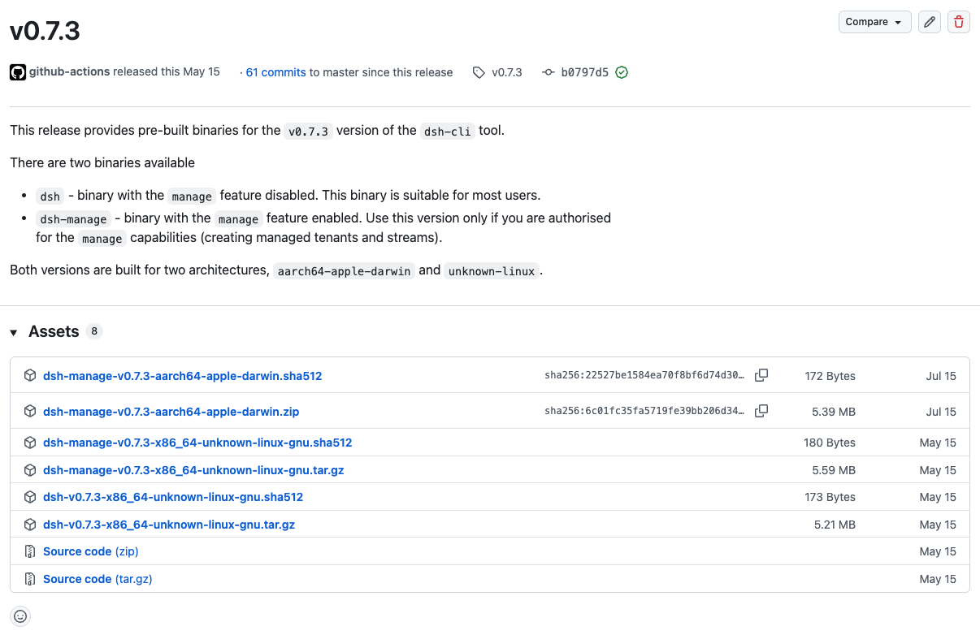
dsh – installation (2)
https://github.com/kpn-dsh/dsh-cli/releases
Pre-built binaries for macos and Linux
macos version signed with KPN developer certificate and notarized
Installation via a package manager (brew install) is still on the roadmap

Slide 7
dsh – authentication & authorization
Robot password
Robot password stored on the system
Environment variable, password file, keychain
Actions not traceable to an individual user
Each platform tenant combination has a different password
Suitable for scripting and CI/CD
Single sign on
OAuth 2.0 / OpenId / Grip
No password needs to be stored (although an encrypted short-lived refresh-token is)
Actions traceable to an individual user
User is authenticated for all platforms and tenants that he is authorized for
Suitable for interactive use

Slide 8
dsh – robot password
Environment variables
Keychain
> export DSH_CLI_PLATFORM=nplz > export DSH_CLI_TENANT=greenbox-dev > export DSH_CLI_PASSWORD_FILE=../np-aws-lz-dsh.greenbox-dev.pwd
> dsh service list
...
> dsh target create nplz greenbox-dev
create new target configuration
enter password
target 'greenbox-dev@np-aws-lz-dsh' created
> dsh service list
...

Slide 9
dsh – single sign on
> dsh service list
please log in to platform np-aws-lz-dsh using the 'dsh login' command
user is not authenticated
> dsh login
login to platform np-aws-lz-dsh
opening login page for platform np-aws-lz-dsh
you are logged in as schel104
authorized tenants: ajuc, greenbox-dev, ...
> dsh service list
...
Login on another platform: > dsh login –-platform prod-aws-lz-dsh
Logout > dsh logout

Slide 10
dsh --help
> dsh -h
> dsh -h
> dsh –help
> dsh service -h
> dsh service show -h
> dsh settings
> dsh –-env-vars

Slide 11
dsh api
> dsh api -h
List and call DSH resource management api.
Usage: dsh api [OPTIONS] [COMMAND]
Commands:
delete Call delete operation
get Call get operation
post Call post operation
put Call put operation
show Print the open api specification

Slide 12
dsh app
> dsh app -h
Show, manage and list apps deployed from the DSH app catalog.
Usage: dsh app [OPTIONS] [COMMAND]
Commands:
deploy Deploy app
explain Explain manifest configuration
list List deployed apps
open Open app vhost
show Show deployed app configuration
undeploy Undeploy app

Slide 13
dsh bucket
> dsh bucket -h
Show, manage and list DSH buckets.
Usage: dsh bucket [OPTIONS] [COMMAND]
Commands:
create Create new bucket
delete Delete bucket
list List buckets
show Show bucket configuration

Slide 14
dsh certificate
> dsh certificate -h
Show, manage and list DSH certificates.
Usage: dsh certificate [OPTIONS] [COMMAND]
Commands:
list List certificates
show Show certificate configuration

Slide 15
dsh env
> dsh env find -h
Find environment variable values
Usage: dsh env find [OPTIONS] <QUERY>
Arguments:
<QUERY> Query
Command options:
-r, --regex Query string is regular expression matching env value
--started Include only started apps/services
--stopped Include only stopped apps/services

Slide 16
dsh image
> dsh image -h
Show, manage and list DSH certificates.
Usage: dsh image [OPTIONS] [COMMAND]
Commands:
find Find used images
list List images

Slide 17
dsh manifest
> dsh manifest -h
Show App Catalog manifests.
Usage: dsh manifest [OPTIONS] [COMMAND]
Commands:
explain Explain manifest configuration
export Export manifest
list List manifests
show Show manifest configuration

Slide 18
dsh metric
> dsh metric list -h
List exported metrics
Usage: dsh metric list [OPTIONS] [COMMAND]
Command options:
--started Include only started apps/services
--stopped Include only stopped apps/services

Slide 19
dsh platform (1)
> dsh platform -h
Show, list and open platform resources.
Usage: dsh platform [OPTIONS] [COMMAND]
Commands:
export Export default platform configuration
list List platforms
open Open console or web application
show Show platform data

Slide 20
dsh platform (2)
> dsh platforms
list platforms
┌────────────────────┬────────┬────────────────────┬────────────┬──────────────────────────────────────────────┬───────────────────────────────────────────────┐
│ name │ alias │ realm │ production │ description │ console url │
├────────────────────┼────────┼────────────────────┼────────────┼──────────────────────────────────────────────┼───────────────────────────────────────────────┤
│ k8s-dev-aws-lz-dsh │ devlz │ k8s-dev-aws-lz-dsh │ false │ Development platform for Klarrio │ https://console.dev.dsh-k8s.np.aws.kpn.com │
│ np-aws-lz-dsh │ nplz │ dev-lz-dsh │ false │ Staging platform for KPN internal tenants │ https://console.dsh-dev.dsh.np.aws.kpn.com │
│ poc-aws-dsh │ poc │ poc-dsh │ true │ Staging platform for non KPN tenants │ https://console.poc.kpn-dsh.com │
│ prod-aws-dsh │ prod │ prod-dsh │ true │ Production platform for non KPN tenants │ https://console.kpn-dsh.com │
│ prod-aws-lz-dsh │ prodlz │ prod-lz-dsh │ true │ Production platform for KPN internal tenants │ https://console.dsh-prod.dsh.prod.aws.kpn.com │
│ prod-azure-dsh │ prodaz │ prod-azure-dsh │ true │ Production platform for non KPN tenants │ https://console.az.kpn-dsh.com │
└────────────────────┴────────┴────────────────────┴────────────┴──────────────────────────────────────────────┴───────────────────────────────────────────────┘

Slide 21
dsh proxy
> dsh proxy -h
Show, manage and list DSH Kafka proxies.
Usage: dsh proxy [OPTIONS] [COMMAND]
Commands:
delete Delete proxy
list List proxies
show Show Kafka proxy configuration

Slide 22
dsh secret
> dsh secret -h
Show, manage and list DSH Kafka proxies.
Usage: dsh secret [OPTIONS] [COMMAND]
Commands:
create Create new secret
delete Delete secret
list List secrets
show Show secret configuration or value
update Update secret

Slide 23
dsh service
> dsh service -h
Show, manage and list services deployed on the DSH.
Usage: dsh service [OPTIONS] [COMMAND]
Commands:
create Create service
delete Delete service
duplicate Duplicate service configuration
edit Edit service configuration
export Export service configuration
list List services
open Open service vhost
restart Restart service
show Show service configuration
start Start service
stop Stop service
update Update service

Slide 24
dsh setting
> dsh setting -h
Show, manage and list dsh settings.
Usage: dsh setting [OPTIONS] [COMMAND]
Commands:
default Set default platform and tenant
list List settings
set Set setting
unset Unset setting

Slide 25
dsh stream
> dsh stream -h
Show, manage and list internal and public managed streams.
Usage: dsh stream [OPTIONS] [COMMAND]
Commands:
create Create stream
delete Delete managed stream
list List streams
show Show manages stream configuration

Slide 26
dsh target
> dsh target -h
Show, manage and list dsh target configurations.
Usage: dsh target [OPTIONS] [COMMAND]
Commands:
create Create a new target configuration
delete Delete target configuration
list List all target configurations

Slide 27
dsh tenant
> dsh tenant -h
Show and manage tenants on the DSH.
Usage: dsh tenant [OPTIONS] [COMMAND]
Commands:
create Create managed tenant
delete Delete managed tenant
grant Grant access rights
list List managed tenants
revoke Revoke access rights
show Show managed tenant configuration
update Update managed tenant limits

Slide 28
dsh token
> dsh token -h
Request DSH tokens.
Usage: dsh token [OPTIONS] [COMMAND]
Commands:
copy Copy token to clipboard
fetch Fetch token
show Sow token payload

Slide 29
dsh topic
> dsh topic -h
Show, manage and list DSH scratch topics.
Usage: dsh topic [OPTIONS] [COMMAND]
Commands:
create Create new scratch topic
delete Delete scratch topic
list List scratch topics
show Show scratch topic configuration

Slide 30
dsh vhost
> dsh vhost list -h
List used vhosts
Usage: dsh vhost list [OPTIONS]
Command options:
--started Include only started apps/services
--stopped Include only stopped apps/services
--usage Include the vhost’s usages

Slide 31
dsh volume
> dsh volume -h
Show, manage and list DSH volumes.
Usage: dsh volume [OPTIONS] [COMMAND]
Commands:
create Create new volume
delete Delete volume
list List volumes
show Show volume configuration

Slide 32
dsh – generic options
Options:
--dry-run Execute in dry-run mode
--force Force changes without confirmation
--password-file <FILE> Provide target password file name
-p, --platform <PLATFORM> Provide target platform [possible values: ...]
-t, --tenant <TENANT> Provide target tenant
-h, --help Print help (see more with '--help')
Output options:
-o, --output-format <FORMAT> Set output format [possible values:...]
-q, --quiet Run in quiet mode
-v, --verbosity <VERBOSITY> Set verbosity level [possible values: ...]

Slide 33
dsh – special options
Special options:
--authentication <METHOD>
Controls authentication [robot, single-sign-on]
--browser <METHOD>
Controls browser behaviour [instruct, open]
-e, --environment-variable <ENV_VAR=value>
Set environment variable from the command line
--env-vars
List all environment variables and their value (if set)
--generate-autocomplete-file <SHELL>
Generate an autocomplete file [bash, elvish, fish, powershell, zsh]
--log-level <LEVEL>
Set logging level [off, error, warn, info, debug, trace]
--suppress-exit-status
Always return exit status 0 (also when an error occurred)
--version
Print version of the tool and some dependencies

Slide 34
rtfm

